Slide 1


Intro to H2O
Lauren DiPerna // Data Scientist @ H2O
Charlotte, NC // June 11, 2018

Slide 2
The Agenda
What is H2O
How does H2O Core work?
The Python API
The Use Case Dataset
How to Learn From Data
How to use AutoML?

Slide 3
What is H2O.ai? The AI Company that builds ML Products

Slide 4

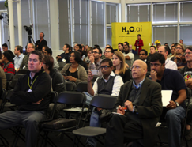


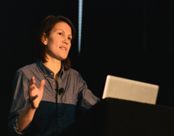
H2O.ai: Company Overview
Founded | 2011 Venture-backed, Debuted in 2012
Products
Mission | Operationalize Data Science & Platform to Build Beautiful Data Products
Team | 75+ employees: Distributed Systems Engineers , ML Experts, World-class Visualization Designers
Headquarters | Mountain View, CA
H2O-3
E. Steam
Sparkling Water
DAI
H2O4GPU

Slide 5
What is H2O-3? Powerful Platform for End-to-End Machine Learning

Slide 6
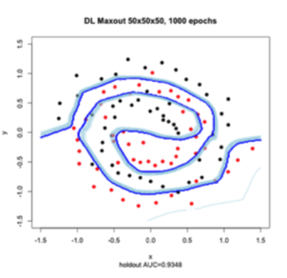
What is H2O-3?
Java-Based Software for In-Memory Data Modeling
Open Source
Big Data Ecosystem
Flexible Interface
Smart and Fast Algorithms
H₂O Flow

Slide 7
What is H2O-3?
Java-Based Software for In-Memory Data Modeling
Scalability and Performance
Rapid Model Deployment
GPU Enablement*
Cloud Integration
Highly portable models deployed in Java (POJO)
Automated and streamlined scoring service deployment with Rest API*
Distributed In-Memory Computing Platform
Distributed Algorithms
Fine-Grain MapReduce

Slide 8
Why H2O-3?
x1 | x2 | x3 | … | xp | y
 |  |  | …
 |  |  | …
 |  |  | …
 |  |  | …
 |  |  | …
 |  |  | …
x1 | x2 | x3 | … | xp | y
 |  |  | …
 |  |  | …
 |  |  | …
 |  |  | …
 |  |  | …
 |  |  | …
x1 | x2 | x3 | … | xp | y
 |  |  | …
 |  |  | …
 |  |  | …
 |  |  | …
 |  |  | …
 |  |  | …
x1 | x2 | x3 | … | xp | y
 |  |  | …
 |  |  | …
 |  |  | …
 |  |  | …
 |  |  | …
 |  |  | …
No Data Size Limit
x1 | x2 | x3 | … | xp | y
 |  |  | …
 |  |  | …
 |  |  | …
 |  |  | …
 |  |  | …
 |  |  | …
x1 | x2 | x3 | … | xp | y
 |  |  | …
 |  |  | …
 |  |  | …
 |  |  | …
 |  |  | …
 |  |  | …

Slide 9

Why H2O-3?
💛 R + 💛 Py. + 💛UI

Slide 10

Why H2O-3?
EASY
Live
Results!
H2O

Slide 11
How to think about H2O-3?
H2O.ai the Company

Slide 12
H2O.ai the Company

Slide 13
H2O.ai the Company
All H2O Products

Slide 14
H2O.ai the Company
H2O Products

Slide 15
H2O.ai the Company
H2O Products
H2O-3
Enterprise Steam
Sparkling Water
Driverless AI
H2O4GPU

Slide 16
H2O.ai the Company
H2O Products
H2O-3
Enterprise Steam
Sparkling Water
Driverless AI
H2O4GPU

Slide 17
H2O.ai the Company
H2O Products
H2O-3

Slide 18
H2O.ai the Company
H2O Products
H2O-3
The APIs

Slide 19
H2O.ai the Company
H2O Products
H2O-3
Python, R, Scala

Slide 20
H2O.ai the Company
H2O Products
H2O-3
APIs

Slide 21
H2O.ai the Company
H2O Products
H2O-3
APIs
H2O-Core

Slide 22
H2O.ai the Company
H2O Products
H2O-3
APIs
JAVA

Slide 23
Where does H2O-3 Fit?
HERE

Slide 24

HERE

Slide 25
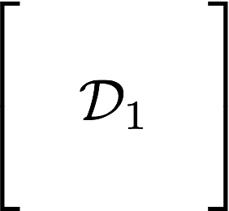

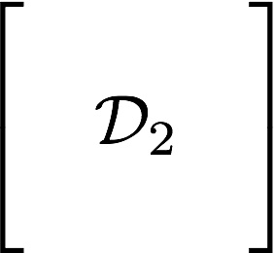
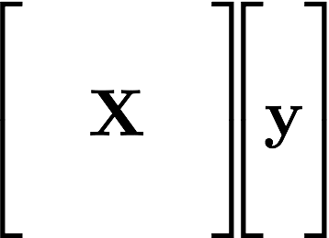




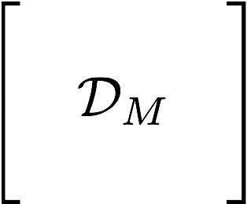
The Machine Learning Pipeline
Data Integration
& Quality
Model
Training
Model
Feature
Engineering
M
Feature
Preprocessing

Slide 26
This is Where H2O-3 Helps
Data Integration
& Quality
Model
Training
Model
Feature
Engineering
M
Feature
Preprocessing
H2O

Slide 27
Everything in One Place
Machine Learning Toolkit

Slide 28
Everything in One Place
Tackle ML Challenges

Slide 29
Current Algorithm Overview
Statistical Analysis
Linear Models (GLM)
Naïve Bayes
Ensembles
Random Forest
Distributed Trees
Gradient Boosting Machine
Stacking / Super Learner
Deep Neural Networks
MLP
Autoencoder
Anomaly Detection
Deep Features
Clustering
K-Means (Auto-K)
Dimension Reduction
Principal Component Analysis
Generalized Low Rank Models
Word Embedding
Word2Vec
Time Series
iSAX
Machine Learning Tuning
Hyperparameter Search
Early Stopping

Slide 30



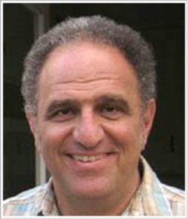
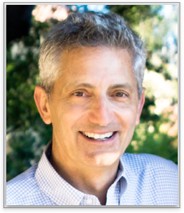
cientific Advisory Council
Dr. Trevor Hastie
PhD in Statistics, Stanford University
John A. Overdeck Professor of Mathematics, Stanford University
Co-author, The Elements of Statistical Learning: Prediction, Inference and Data Mining
Co-author, Generalized Additive Models
108,404 citations (via Google Scholar)
Dr. Robert Tibshirani
PhD in Statistics, Stanford University
Professor of Statistics and Health Research and Policy, Stanford University
COPPS Presidents’ Award recipient
Co-author, The Elements of Statistical Learning: Prediction, Inference and Data Mining
Author, Regression Shrinkage and Selection via the Lasso
Co-author, An Introduction to the Bootstrap
Dr. Steven Boyd
PhD in Electrical Engineering and Computer Science, UC Berkeley
Professor of Electrical Engineering and Computer Science, Stanford University
Co-author, Convex Optimization
Co-author, Linear Matrix Inequalities in System and Control Theory
Co-author, Distributed Optimization and Statistical Learning via the Alternating Direction Method of Multipliers

Slide 31
H2O Core What Makes Machine learning at Scale Possible

Slide 32
How H2O Core Works
H2O
(just a java application)

Slide 33

How H2O Core Works
H2O

Slide 34

How H2O Core Works
H2O
H2O
H2O
H2O
on a laptop
on a virtual machine
in a container

Slide 35



H2O Core
Model Building
CPU

Slide 36
H2O Core
H2O
H2O
H2O

Slide 37
H2O Core
Model Building
H2O Distributed In-Memory
CPU
CPU
CPU

Slide 38




H2O Core with Other Data Sources
Model Building
H2O Distributed In-Memory
CPU
CPU
CPU
YARN

Slide 39



H2O Core with Other Data Sources
NFS
Model Building
SQL
H2O Distributed In-Memory
CPU
CPU
CPU
S3

Slide 40
H2O Distributed Environments
H2O
H2O
H2O
H2O
H2O
H2O
H2O
H2O
distributed across multiple machines
distributed on the cloud

Slide 41

Interfacing with H2O (Python, R, and Flow)

Slide 42
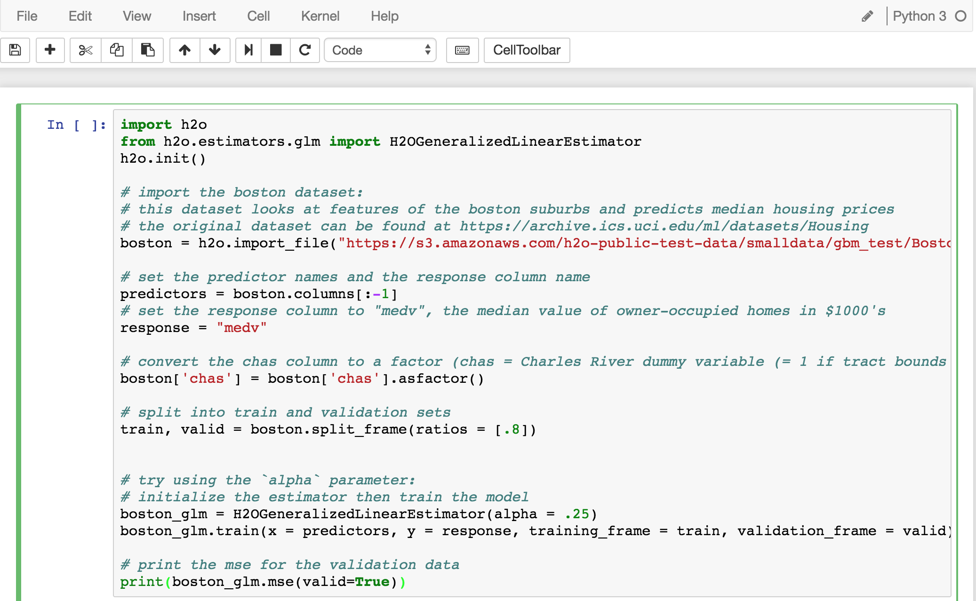
Python API

Slide 43
Python API
Import the python package

Slide 44
Python API
Launch an H2O cluster

Slide 45
Python API
Import a Dataset

Slide 46
Python API
Build a Model

Slide 47
Python API
Get Model Performance

Slide 48
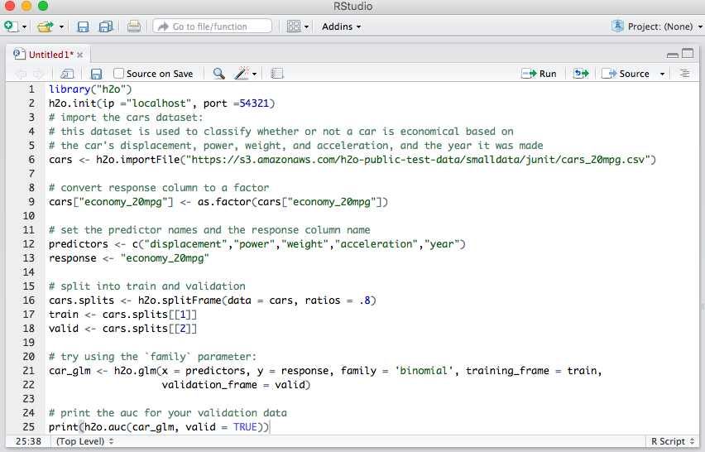
R API

Slide 49
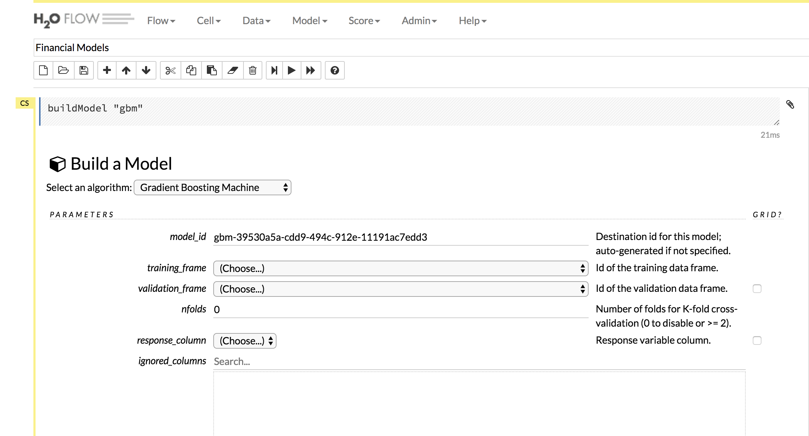
Flow: Custom Web UI

Slide 50
The H2O Python API* (how the client & server communicate)
*Same applies for R

Slide 51

Client & Cluster Communication
H2O Cluster
REST/ JSON
H2O
H2O
H2O Client

Slide 52
Communication Layers: A Command
Importing Big Data with Python Code
Path to Your Dataset
Python Commands
h2o.import_file(…)
H2O
the Client
Local
Machine

Slide 53
Communication
h2o.import_file(…)
requests file import
REST / JSON
H2O
H2O Cluster
H2O
Local
Machine

Slide 54
Cluster Does Heavy Lifting
H2O Cluster
REST/ JSON
H2O
Local
Machine

Slide 55
Cluster Does Heavy Lifting
H2O Cluster
REST/ JSON
H2O
JVM 1
JVM 2
JVM N
Local
Machine

Slide 56
Cluster Does Heavy Lifting
H2O Cluster
REST/ JSON
H2O
JVM 1
JVM 2
JVM N
Local
Machine

Slide 57
Cluster Does Heavy Lifting
H2O Cluster
REST/ JSON
x1 | x2 | x3 | … | xp | y
H2O
JVM 1
JVM 2
JVM N
Local
Machine

Slide 58
H2O Client
cluster returns
frame key
REST/ JSON
x1 | x2 | x3 | … | xp | y
H2O
JVM 1
JVM 2
JVM 2
JVM N
Local
Machine

Slide 59
The Use Case (about our data)

Slide 60

Backorders Dataset

Slide 61
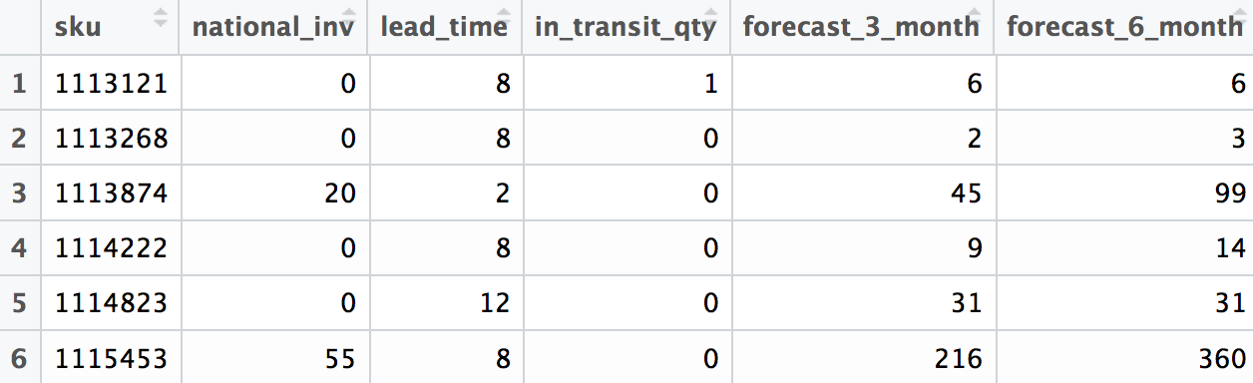
The Backorders Data

Slide 62
The Use Case: End Goal
Predict if a product will go on backorder

Slide 63
The Use Case: End Goal
Predict if a product will go on backorder
(based on our historic backorders data)

Slide 64
The Use Case: End Goal
Build a model to predict
our target:
Yes | No

Slide 65
The Use Case: End Goal
Build a model to predict
our target (aka Ŷ):
Yes | No

Slide 66
The Use Case: End Goal
Build a model to predict
our target (aka response column):
Yes | No

Slide 67
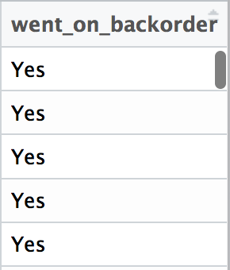
The Use Case: End Goal
Build a model to predict
our target:
Yes | No

Slide 68
Given Data: How to Learn?
How does an algorithm learn from data ?

Slide 69
Learning from Data
Modeling Table

Slide 70
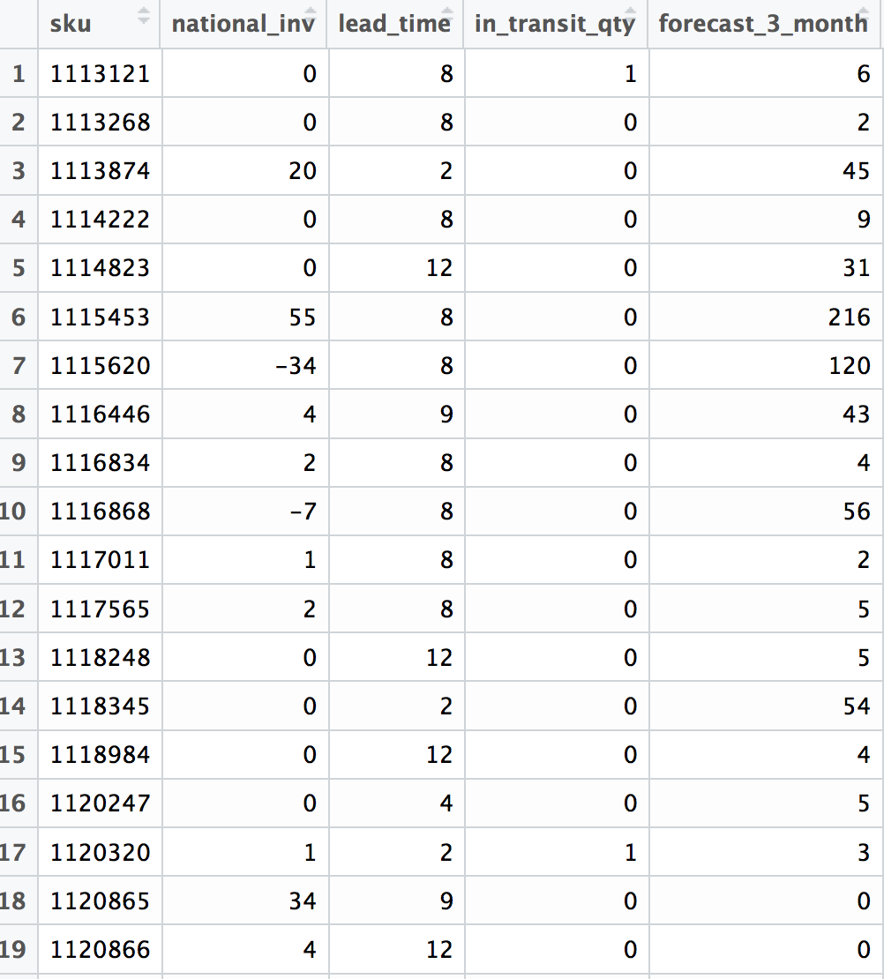
Learning from Data
… | went_on_backorder
… | YES
… | NO
… | YES
… | YES
… | NO
… | NO

Slide 71
Learning from Data
… | went_on_backorder
… | YES
… | NO
… | YES
… | YES
… | NO
… | NO
observations

Slide 72
Learning from Data
… | went_on_backorder
… | YES
… | NO
… | YES
… | YES
… | NO
… | NO
training ex.

Slide 73
Learning from Data
… | went_on_backorder
… | YES
… | NO
… | YES
… | YES
… | NO
… | NO
(x, y)

Slide 74
Learning from Data
X
Y
(x, y)

Slide 75
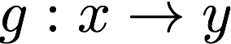
Learning from Data
X
Y
ALGO
Learn the Pattern

Slide 76
Learning from Data
New Input Data
X
Ŷ
ALGO

Slide 77
Supervised Learning
REGRESSION
How much will a claim cost?
CLASSIFICATION
Will a borrower default on loan?

Slide 78
Supervised Learning
claim cost
insurance tier

Slide 79
Supervised Learning
claim cost
insurance tier

Slide 80
Supervised Learning
claim cost
insurance tier

Slide 81
Supervised Learning
claim cost
insurance tier

Slide 82
Supervised Learning
claim cost
insurance tier

Slide 83
Supervised Learning
no
claim cost
age
yes
insurance tier
income

Slide 84
Supervised Learning
no
claim cost
age
yes
insurance tier
income

Slide 85
Supervised Learning
no
claim cost
age
yes
insurance tier
income

Slide 86
Supervised Learning
no
claim cost
age
yes
insurance tier
income

Slide 87
Current Algorithm Overview
Statistical Analysis
Linear Models (GLM)
Naïve Bayes
Ensembles
Random Forest
Distributed Trees
Gradient Boosting Machine
Stacking / Super Learner
Deep Neural Networks
MLP
Autoencoder
Anomaly Detection
Deep Features
Clustering
K-Means (Auto-K)
Dimension Reduction
Principal Component Analysis
Generalized Low Rank Models
Word Embedding
Word2Vec
Time Series
iSAX
Machine Learning Tuning
Hyperparameter Search
Early Stopping
Supervised
Algorithms

Slide 88
Intro to H2O’s AutoML Scalable Automatic Machine Learning

Slide 89
AutoML Agenda
The Machine Learning Pipeline
What is Automatic Machine Learning?
How to Use H2O’s AutoML

Slide 90
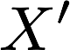
Updated Machine Learning Pipeline
Data Integration
& Quality
Model
Training
Model
predictions
M
Modeling
Table
Feature
Preprocessing
Model
Selection

Slide 91
Updated Machine Learning Pipeline
Data Integration
& Quality
Model
Training
Model
predictions
M
Modeling
Table
Feature
Preprocessing
Model
Selection
H2O’s AutoML

Slide 92
Automatic ML Overview
Feature Preprocessing
Hyperparameter Search
Ensembles

Slide 93
Feature Preprocessing
Missing Values
Standardization
NA
10
50
30
10
50
30
10
50
0
-1
1

Slide 94
Feature Preprocessing
Handling Categorical Columns
dog
cat
dog
1
0
1
0
1
0
dog
cat
dog
2
1
2
One-hot Encoding
Label Encoder

Slide 95

Feature Preprocessing ≠ Feature Engineering
Timestamp
jan/02/2017
march/03/2019
dec/11/2018
Month | Day | Year
01 | 02 | 2017
03 | 03 | 2019
12 | 11 | 2018
Domain Expertise
Date Expansion

Slide 96
Automatic ML Overview
Feature Preprocessing
Hyperparameter Search
Ensembles

Slide 97
What are Hyperparameters? (a quick review)

Slide 98

What are Model Hyperparameters?
Model
Every model comes with knobs

Slide 99
What are Model Hyperparameters?
max
depth
ntrees
GBM
sample
rate
Every model comes with knobs

Slide 100
What are Hyperparameter?
max
depth
Unlike regular model parameters, hyperparameters are not learned from the data
The user has to set the hyperparameters values
ntrees
sample
rate

Slide 101
What are Hyperparameter?
5
Unlike regular model parameters, hyperparameters are not learned from the data
The user has to set the hyperparameters values
100
.8

Slide 102
What are GLM’s Hyperparameters?
alpha
lambda
GLM

Slide 103
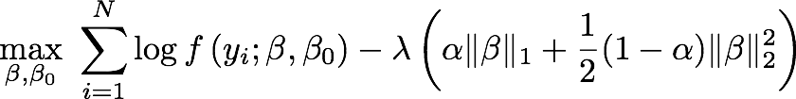
GLM Model Parameters

Slide 104
GLM Model Parameters

Slide 105
GLM Hyperparameter

Slide 106
Model Building: Hyperparameter Search
3 Main Ways:
Manual Model Tuning
Cartesian Grid Search
Random Grid Search*
*What AutoML Uses

Slide 107
Manual Model Tuning
Train
Model
training data
max
depth
ntrees
validation
data
?
Specify
Hyperparameter
Values
Validate
Performance
Split Dataset

Slide 108
Manual Model Tuning
How did you do?
Not so good: Repeat Process
GOOD! : Stop

Slide 109
Cartesian Grid Search
AKA Exhaustive Search: Tries Every Combination

Slide 110
Cartesian Grid Search
ntrees
max depth

Slide 111
Cartesian Grid Search
single trial
ntrees = 1000
max depth = 5
ntrees
max depth

Slide 112
Cartesian Search
single trial
ntrees = 1000
max depth = 10
ntrees
max depth

Slide 113
Cartesian Search
single trial
ntrees = 1000
max depth = 15
ntrees
max depth

Slide 114
Cartesian Grid Search
Cartesian Grid Search
Complete Exploration
ntrees
max depth

Slide 115
Random Grid Search
ntrees
max depth

Slide 116
Random Grid Search
single trial
ntrees = 1000
max depth = 5
ntrees
max depth

Slide 117
Random Grid Search
single trial
ntrees = 3000
max depth = 15
ntrees
max depth

Slide 118
Random Grid Search
Random Grid Search
explores more in less time
ntrees
max depth

Slide 119
Automatic ML Overview
Feature Preprocessing
Feature Engineering
Hyperparameter Search
Ensembles

Slide 120
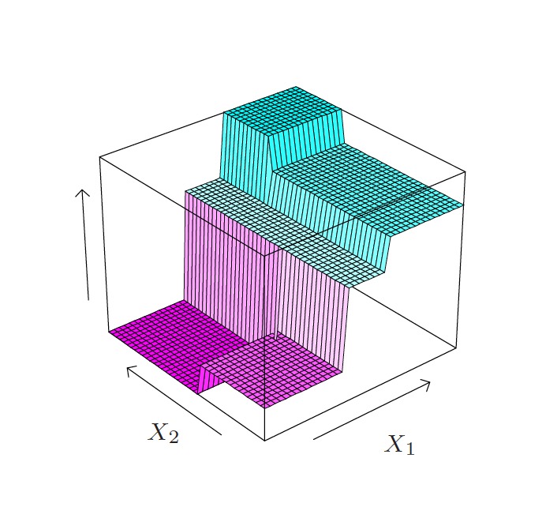
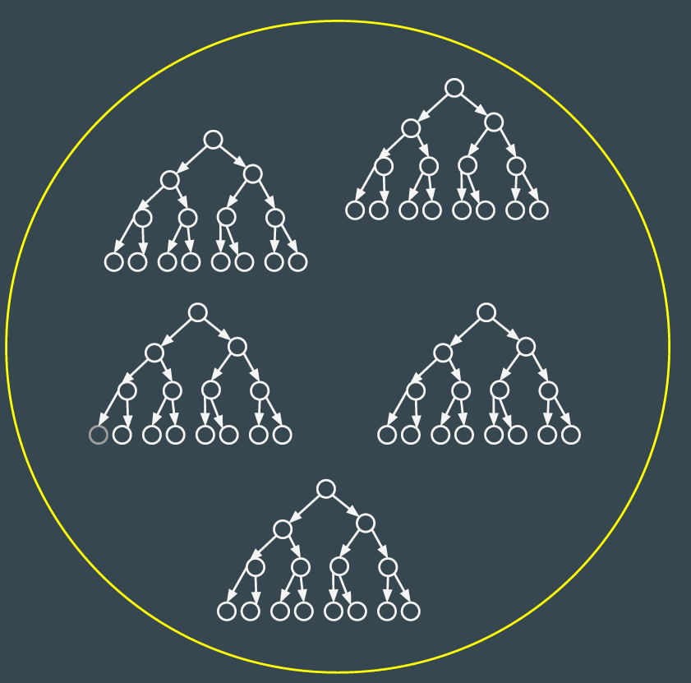
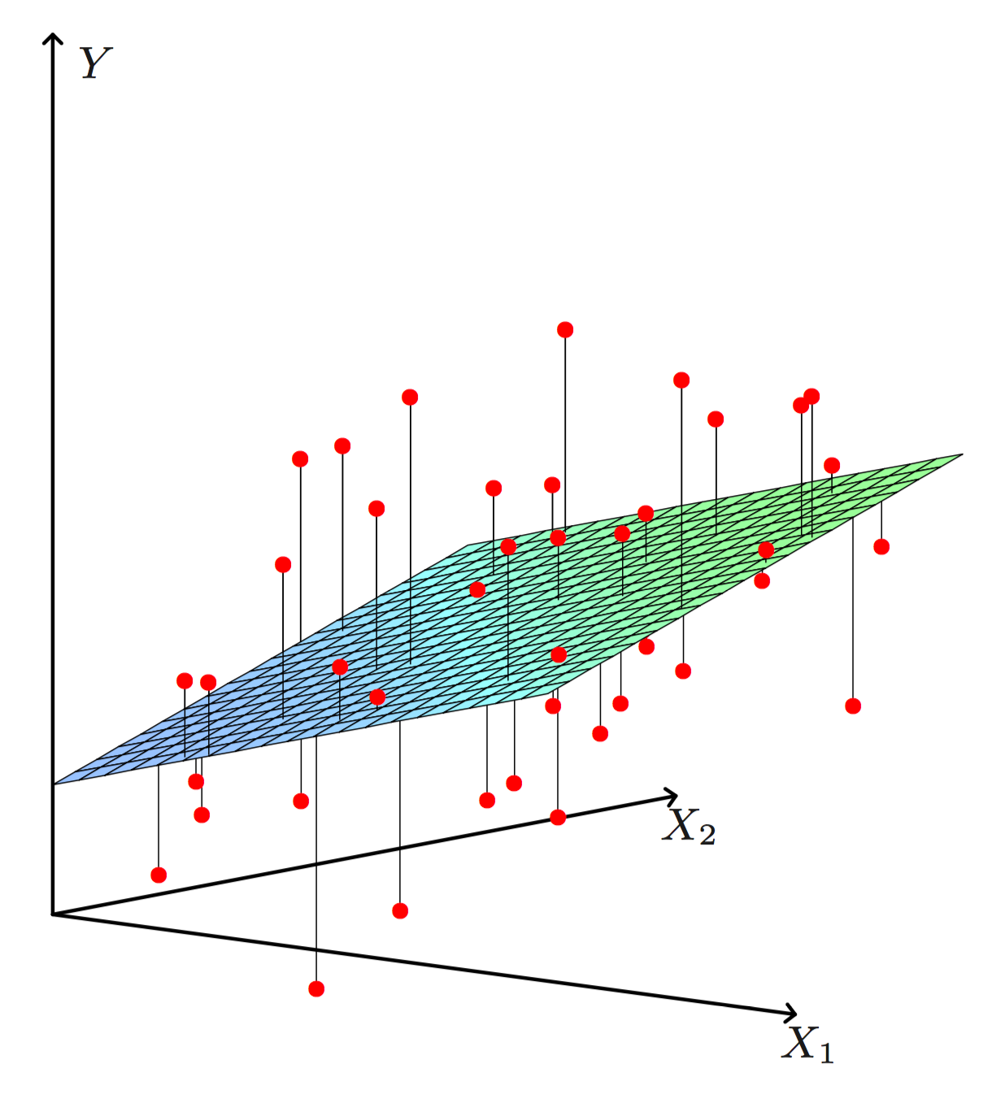
Ensembles
Vanilla Ensembles
Super Learning Ensembles
Gradient Boosting Machine
Random Forest

Slide 121
Ensembles
Vanilla Ensembles
(AKA Stacking)
Gradient Boosting Machine
Random Forest

Slide 122
Stacked Ensemble Steps
Specify original dataset for training
Specify algorithms with which to train
Stack each algo’s cross-validated predictions
Train final model on cross-validated results

Slide 123
p
your original
training data
N
“Level-zero” data

Slide 124
Stacked Ensemble Steps
Specify original dataset for training
Specify algorithms with which to train
Stack each algo’s cross-validated predictions
Train final model on cross-validated results

Slide 125
supervised algos used to train
GLM
DRF
XRT
GBM
DNN
base learners

Slide 126
Stacked Ensemble Steps
Specify original dataset for training
Specify algorithms with which to train
Stack each algo’s cross-validated predictions
Train final model on cross-validated results

Slide 127
L base learners
DR
F
X
R
T
stacking your
base learners
GLM
GBM
DNN
N

Slide 128
L base learners
G
LM
DR
F
X
R
T
GBM
DNN
meaning:
each column is an algorithm’s
cross-validated predictions
N

Slide 129
L base learners
.98
.54
.02
.30
meaning:
each column is an algorithm’s
cross-validated predictions
G
LM
DR
F
X
R
T
GBM
DNN
N

Slide 130
L base learners
10
5.5
7
30
meaning:
each column is an algorithm’s
cross-validated predictions
G
LM
DR
F
X
R
T
GBM
DNN
N

Slide 131
How do we get the cross-validated predictions?

Slide 132
How do we get the cross-validated predictions?
keep_cross_validation_predictions = True

Slide 133
what is cross-validation? quick review

Slide 134

Without K-Fold Cross Validation:
A)
Train
Test

Slide 135
Without K-Fold Cross Validation:
A)
Train
Test
B)
Train
Validate
Test
Model Selection

Slide 136
With K-Fold Cross Validation
5-fold cross validation
for each algo

Slide 137
Train
5-fold cross validation
for each algo

Slide 138
Validate
5-fold cross validation
for each algo

Slide 139
Train
Train
5-fold cross validation
for each algo

Slide 140
Validate
5-fold cross validation
for each algo

Slide 141
5-fold cross validation
for each algo
Continue
Process
.
.
.
.
.
.
.
.
.

Slide 142
Cross-Validated
Prediction Values
Validate
TRAIN
10
5.5
7
30

Slide 143
collect the
cross-validated
predictions

Slide 144
collect the
cross-validated
predictions
N

Slide 145
results for each
algorithm
GLM

Slide 146
results for each
algorithm
DRF

Slide 147
results for each
algorithm
XRT

Slide 148
results for each
algorithm
GBM

Slide 149
results for each
algorithm
DNN

Slide 150
Stacked Ensemble Steps
Specify original dataset for training
Specify algorithms with which to train
Stack each algorithm’s cross-validated predictions
Train final model on cross-validated results

Slide 151
Base Learners’
CV Predictions
Original Target
y

Slide 152
Base Learners’
CV Predictions
Original Target
y
“Level-one” data

Slide 153
Base Learners’
CV Predictions
Original Target
train metalearner
on level-one data
y
“Level-one” data

Slide 154
GLM
train metalearner
on level-one data

Slide 155
Summary: H2O’s AutoML
Imputation, Categorical Encoding & Standardization
Random Grid Search
Early Stopping for Individual Models
2 Stacked Ensembles
Auto-selects Winning Model

Slide 156
The AutoML Experience

Slide 157
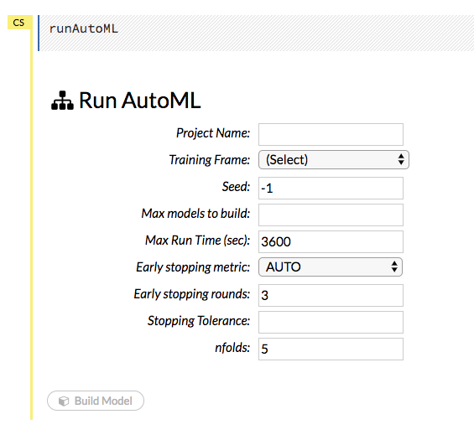
The Interface: Flow
Simplify Machine Learning
2 Required parameters
training frame & response

Slide 158
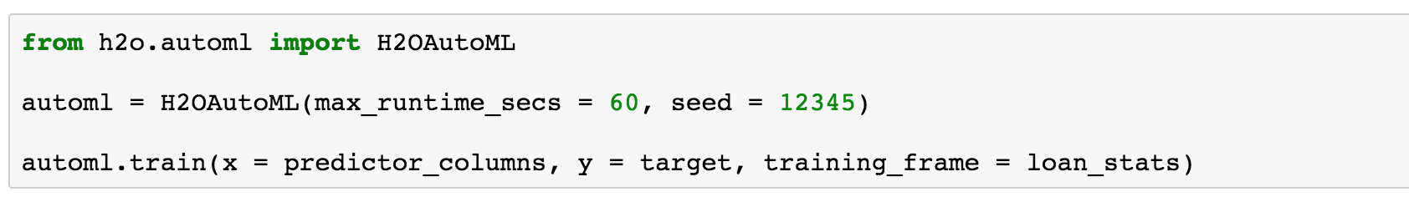
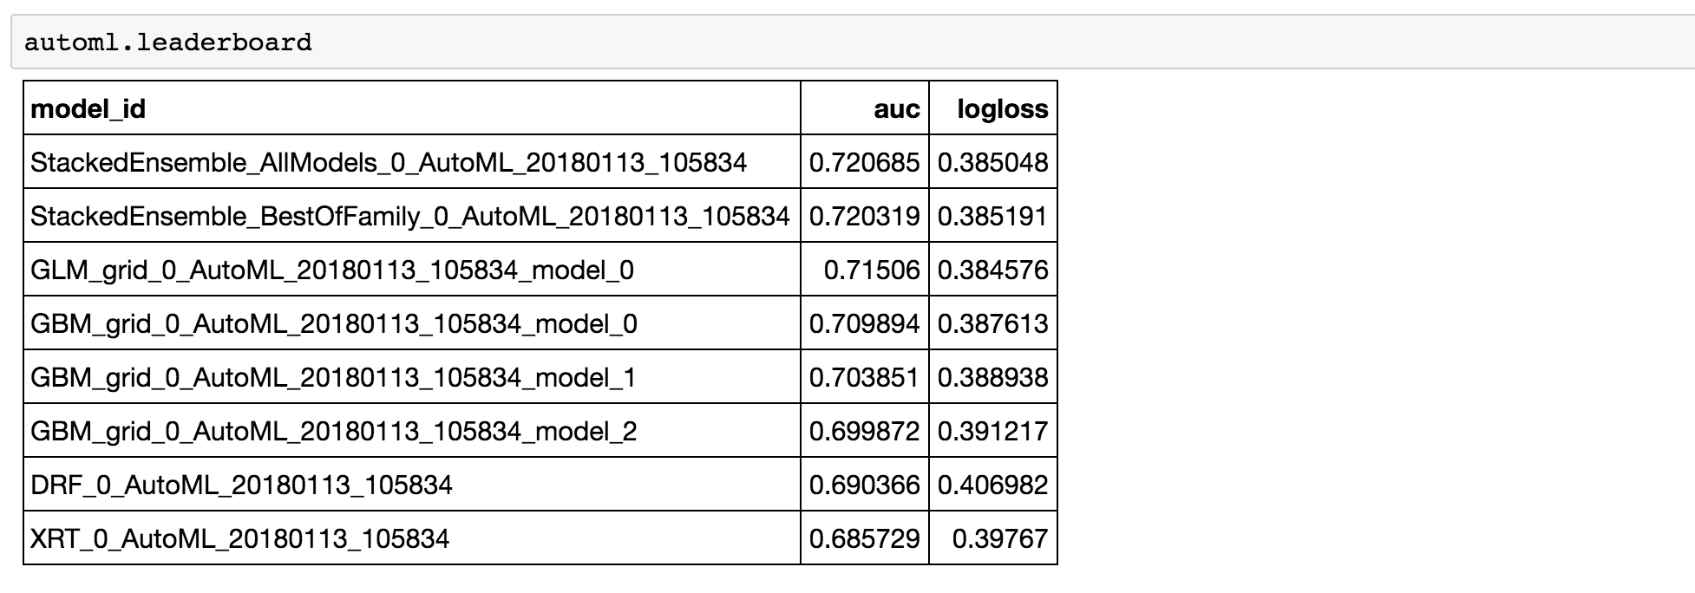
The Interface: Python

Slide 159
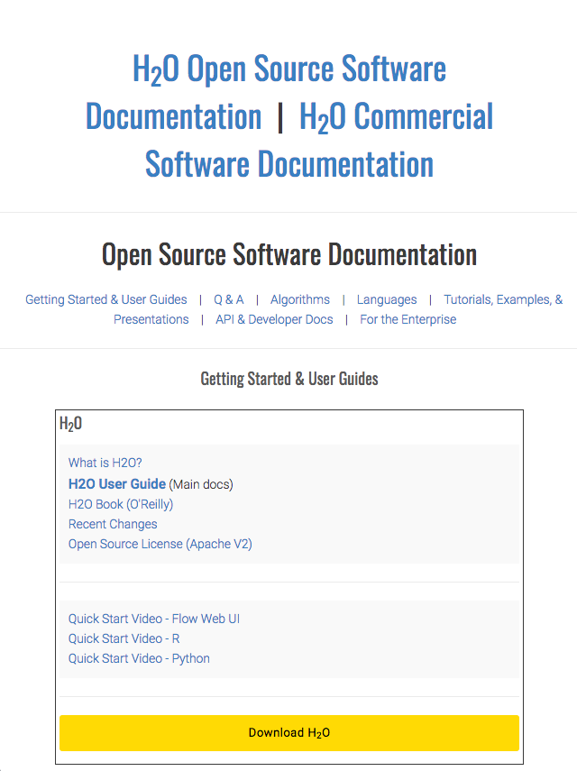
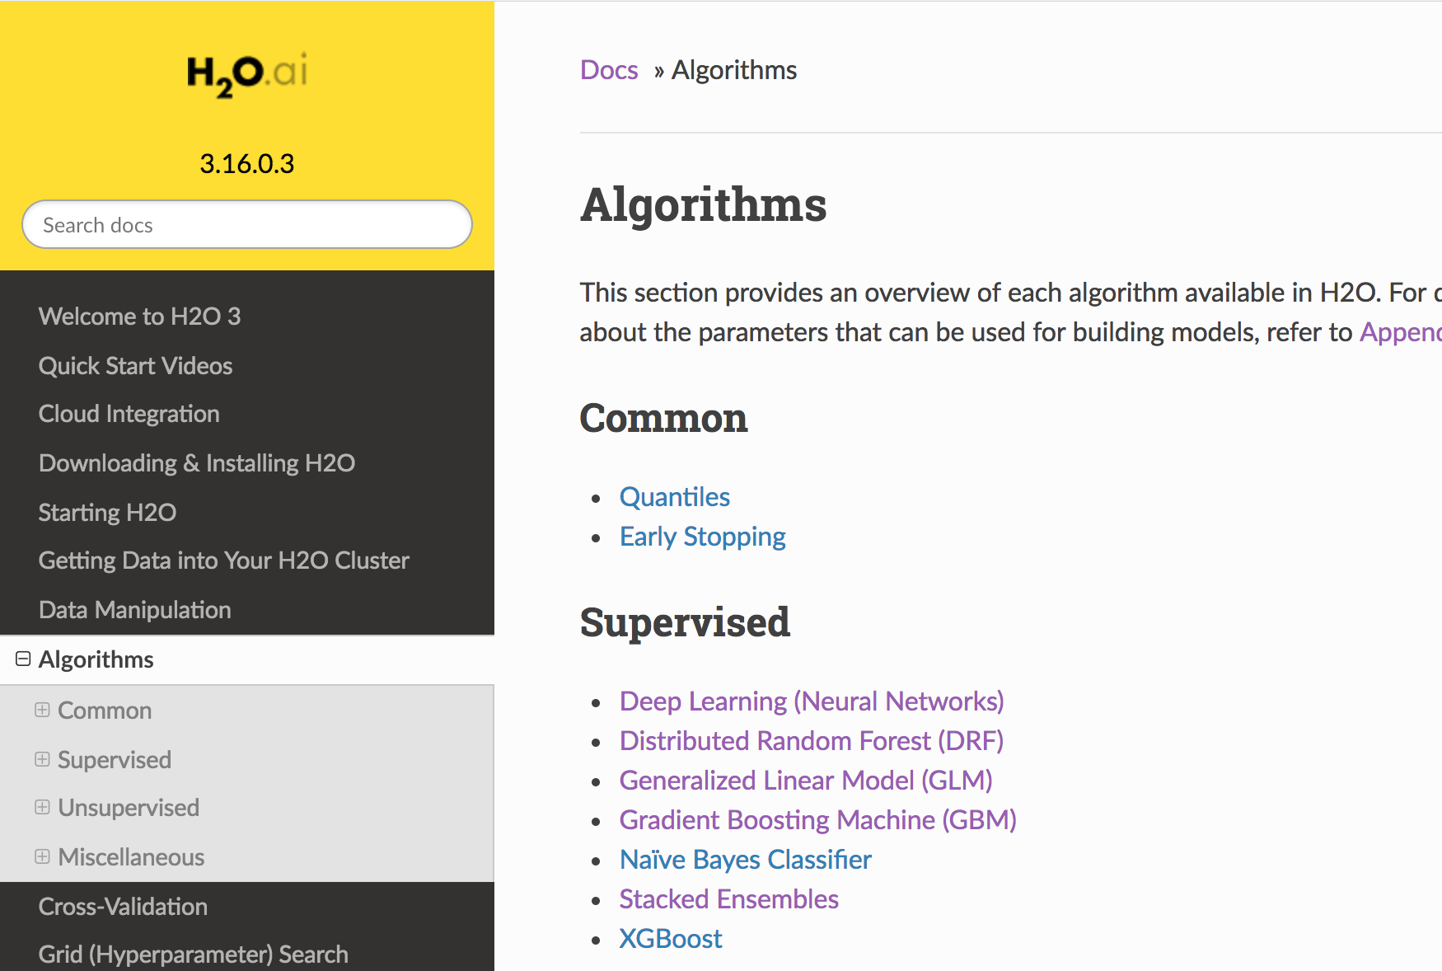
Additional Resources
All Documentation @ http://docs.h2o.ai/h2o/latest-stable/index.html
post questions to: https://stackoverflow.com/questions/tagged/h2o
Send questions to me: laurend@h2o.ai

Slide 160
Thanks!

